Slide 1

TRAVEL PLANNING APPLICATION
TOURIST
ATTRACTION
PLANNER
Plan • Explore • Experience
Presented by:
Bellam Raja Vamsi Teja
Battula Aravind
Gidijala Sai Hasini
Sudha Rakesh

Slide 2
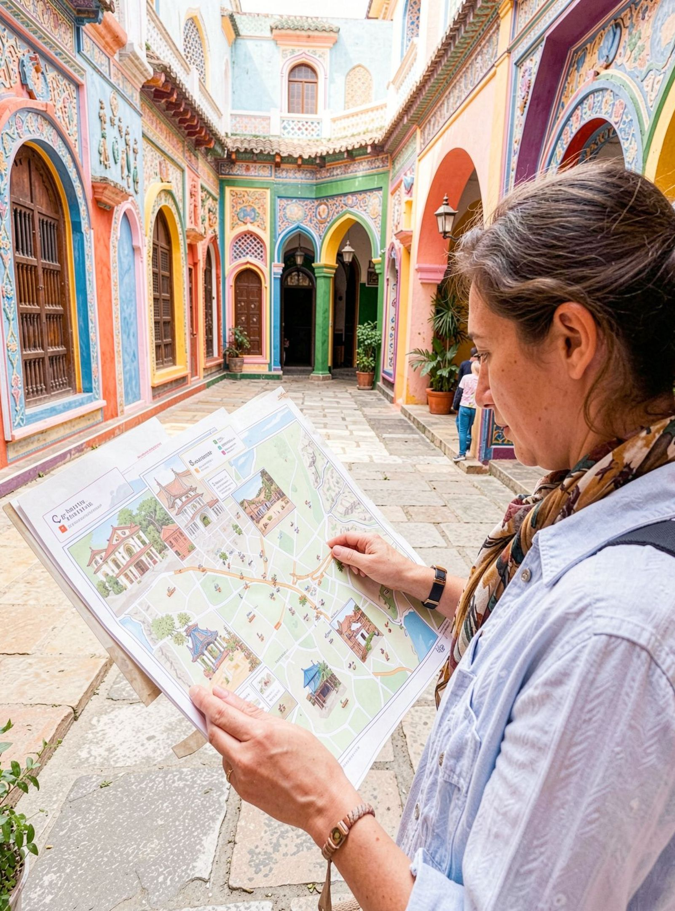


THE IDEA
Travel planning should feel simple and organized
One digital travel-planning application for discovering places and shaping a visit.
Discover popular destinations and explore attraction details in one place.
View locations, timings, activities, and essential visit information.

Slide 3



THE PROBLEM
Travelers lose time when information is scattered
The planning challenge is balancing choices, time, distance, and budget.
Scattered research
Too many places
Hard trade-offs
Finding suitable attractions across different websites is time-consuming.
Planning multiple places in one trip can be difficult.
Users may struggle to balance time, distance, and budget.

Slide 4



THE SOLUTION
One planner brings the trip together
Search
Understand
Search for attractions by destination or category.
See locations, maps, opening hours, ratings, and reviews.
Organize
Estimate travel costs and build a personalized itinerary.
Search, understand, estimate, and organize from one place.

Slide 5




CORE FEATURES
Four features turn ideas into an itinerary
Attraction discovery
Smart planning
Budget planning
Map integration
Search destinations by city or category.
Create a day-wise travel itinerary.
Estimate transportation, food, and entry costs.
View attractions and plan efficient routes.

Slide 6
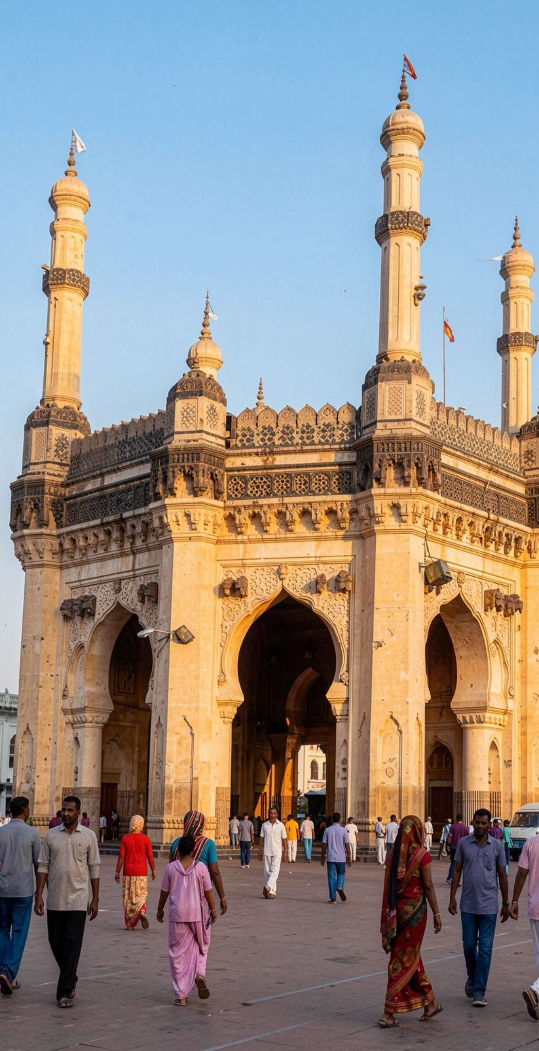


WORKING PROCESS
A Hyderabad trip can be planned step by step
Explore attractions and select places to visit.
User searches for Hyderabad.
Create the itinerary, estimate the budget, and start the journey.
Build a route: Charminar → Golconda Fort → Hussain Sagar → Necklace Road.

Slide 7
THE TAKEAWAY
Tourist Attraction Planner makes travel easier
One organized trip
Clearer planning
Combines attraction discovery, itinerary planning, maps, and budgeting.
Makes travel planning faster, clearer, and more organized.
FUTURE SCOPE
AI recommendations · hotel booking · weather information · personalized travel suggestions
Thank You
Plan Smart. Travel Better. Explore More.

